Slide 1
Discrete-Time Systems
Ajit S. Bopardikar
Conexant Systems India Ltd.
Hyderabad, India

Slide 2

System: Definition
Transformation or an operator that maps an input sequence with values x(n) to an output sequence with values y(n)

Slide 3
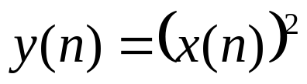
Memoryless/ Static System
A system where the output depends on the present input
The output occurs at the same value of n
Example:
Any other system is known as dynamic

Slide 4
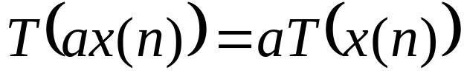
Linear Systems
Satisfy superposition and homogeneity
  Superposition
  Homogeneity

Slide 5
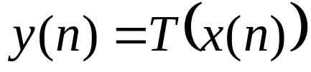
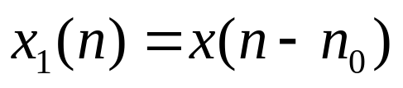
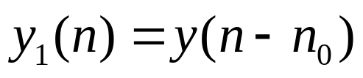
Time/Shift-invariant Systems
A shift/delay in the input results in a corresponding shift/delay in the output
  If
  Then
  Produces
Notes:
Example: Downsampling

Slide 6
Causality
Also called a nonanticipative system.
Output sequence depends only on the present and past input samples

Slide 7


Stable System
A bounded input produces a bounded output
What is a bounded sequence?
For a bounded input, the output will also be bounded

Slide 8
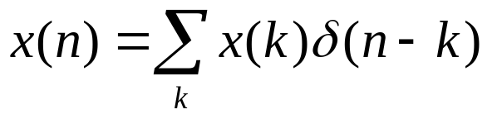
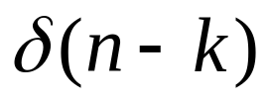
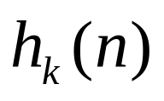
Linear-time/shift Invariant Systems (LTI/LSI)
Any discrete-time sequence can be represented as a weighted linear combination of a train of delta function
Let the response of the system to an impulse be

Slide 9
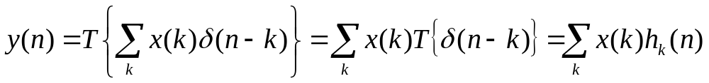
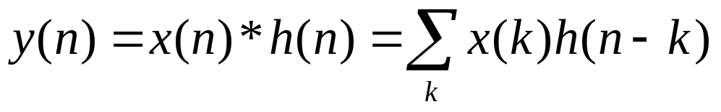
LTI/LSI Systems (Convolution Equation)
Using the principle of superposition
Indicates that the response to any input can be expressed in terms of the response of the system to impulses at different delays
Using Invariance

Slide 10
LTI/LSI Systems
A LTI/LSI system is completely characterized by its impulse response.
Given h(n), one can compute the output of the system to any input

Slide 11
Convolution
If we convolve two sequences of lengths l1 and l2, the resulting sequence has a length of l1+l2-1

Slide 12


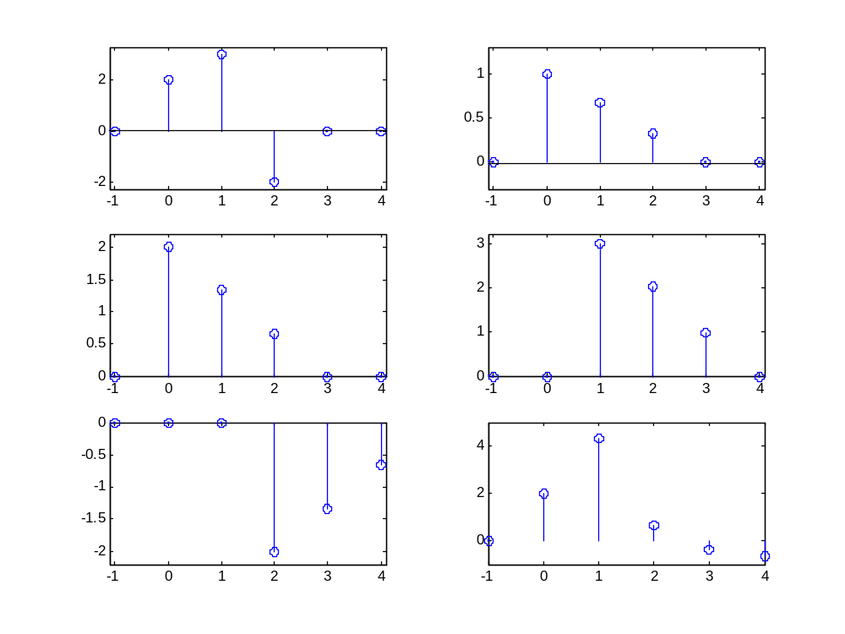




Convolution: Superposition Interpretation

Slide 13






Properties of LTI/LSI Systems

Slide 14
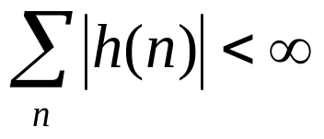
Properties of LTI Systems
LTI/LSI systems are stable if and only if the impulse response is absolutely summable

Slide 15
Properties of LTI/LSI Systems
Systems with only a finite number of samples/coefficients in their impulse response are known as finite-duration impulse response (FIR) systems
FIR systems are stable as long as all the coefficients are finite

Slide 16
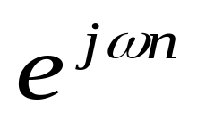
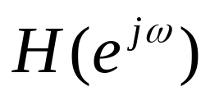
Fourier Transform of Discrete-time Signals
is an eigenfunction of a linear system
Associated eigenvalue is
describes the change in the complex exponential as a function of frequency-Frequency Response of the system

Slide 17
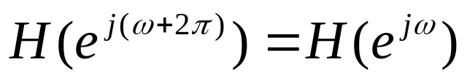
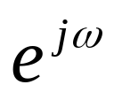
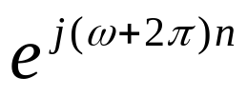
More on Frequency Response
and
are indistinguishable and therefore the response of a system to these is also identical
We can specify H(ω) in any 2π inteval but normally −π<ω<π or 0<ω<2π are used

Slide 18
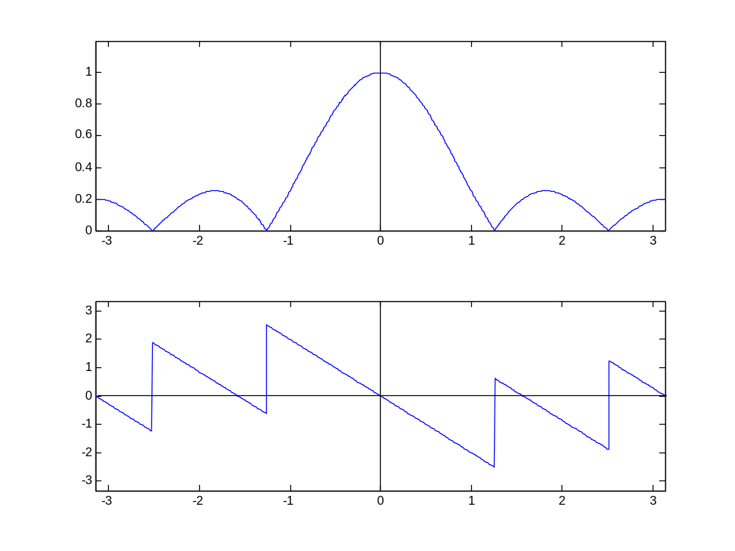

Frequency Response of the Averager

Slide 19

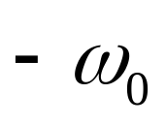
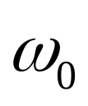


Filters
System that allows some frequencies to pass while attenuating others
Ideal Lowpass Filter

Slide 20

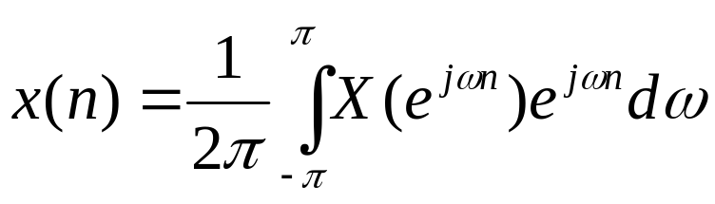
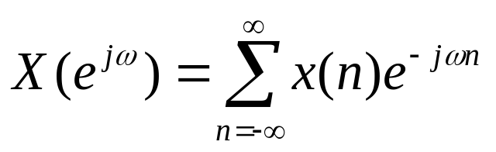
Fourier Representation
Any sequence can be written as a linear combination of discrete time complex exponentials between –π and π
Fourier representation

Slide 21
Features
Fourier Transform is a complex valued function
Fourier transform is also called the Fourier spectrum or spectrum
What kind of signals have a Fourier representation?

Slide 22
Conditions for Convergence
If the input sequence is absolutely summable, then Fourier transform exists-this is sufficient

Slide 23
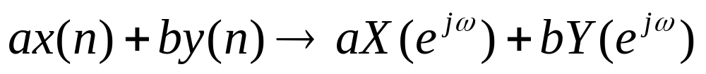
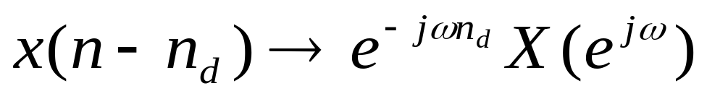
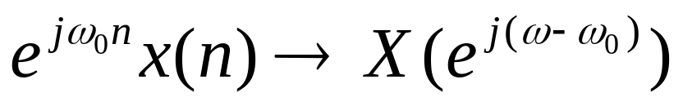
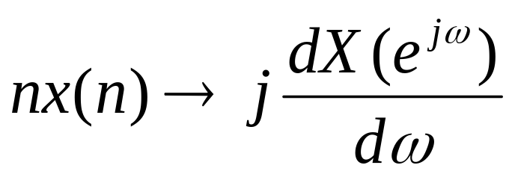
Properties of Fourier Transform

Slide 24
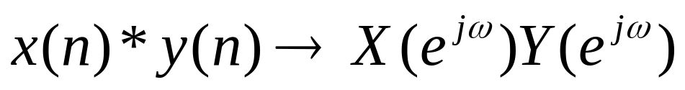
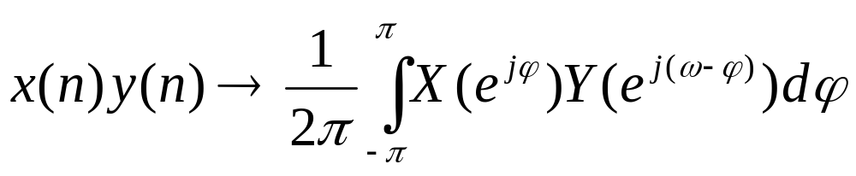
Properties of Fourier Transform

Slide 25
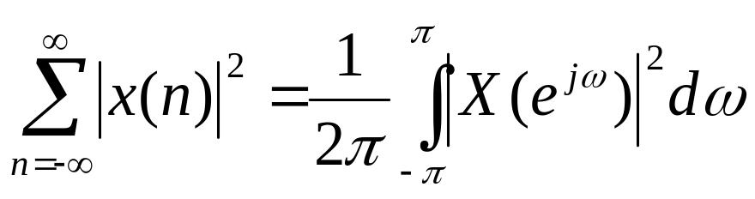
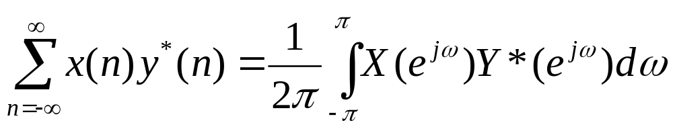
Parseval’s Theorem
Generalized form

Slide 26
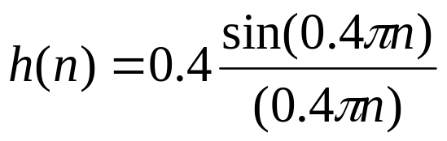
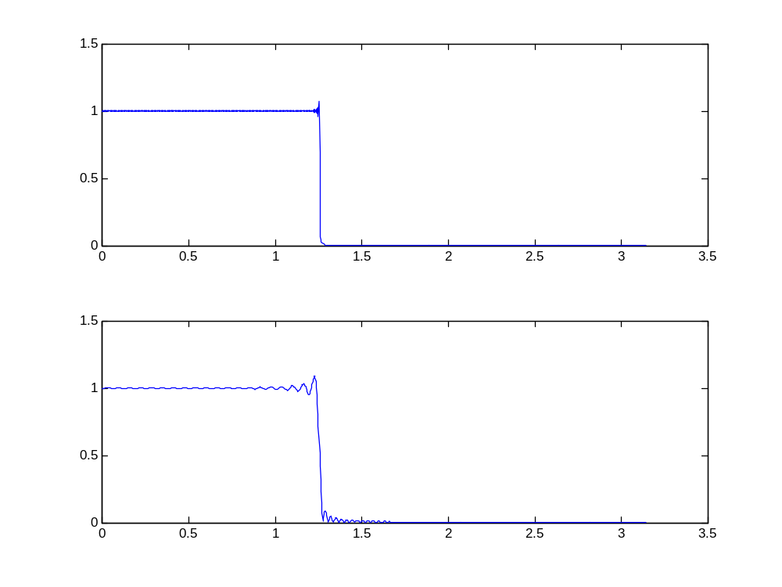


Gibbs Phenomenon

Slide 27
Uses of the DTFT
Spectral analysis
Computational efficiency
Audio Equalizer

Slide 28
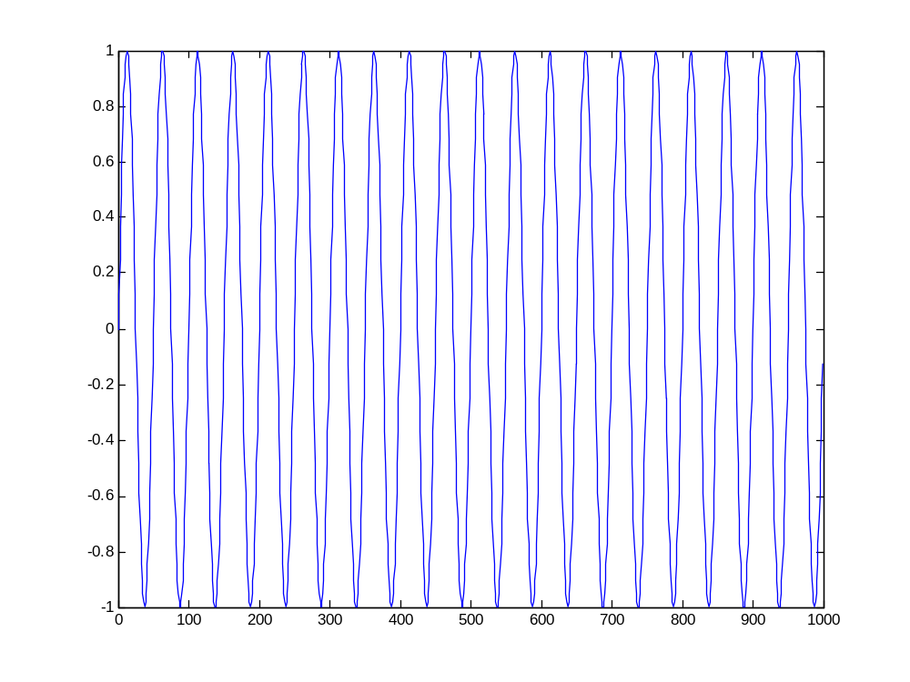
Spectrum Analysis: Input SignalSamples
n

Slide 29
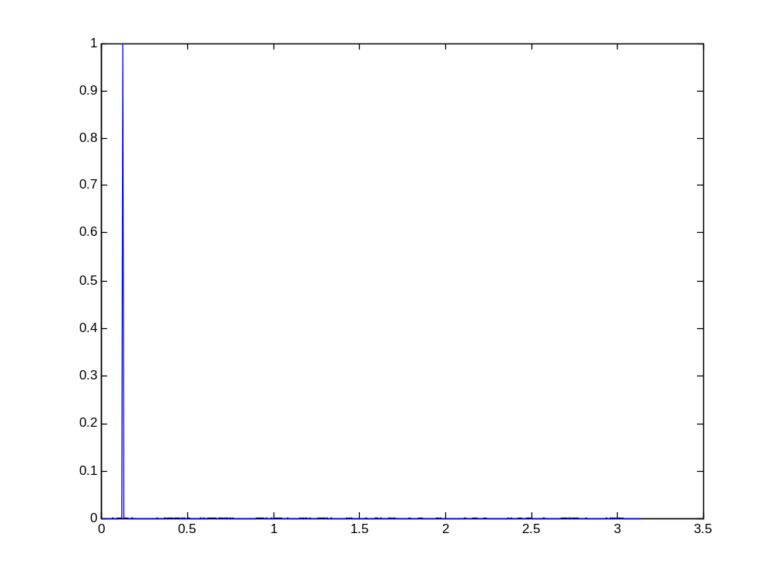
Spectrum Analysis: Fourier Transform
ω

Slide 30
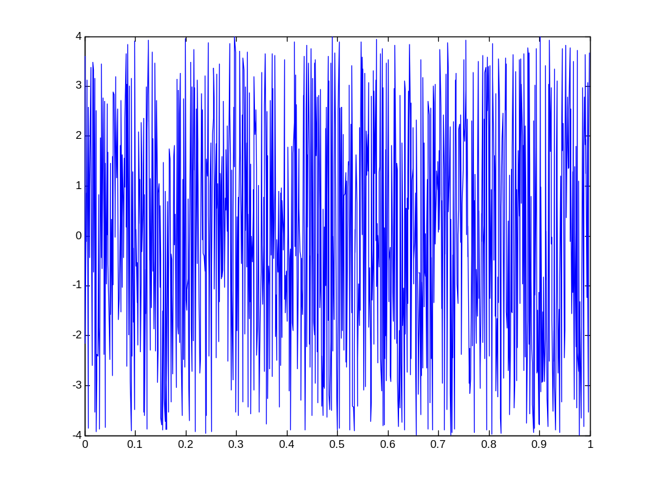
Spectrum Analysis: Noise

Slide 31
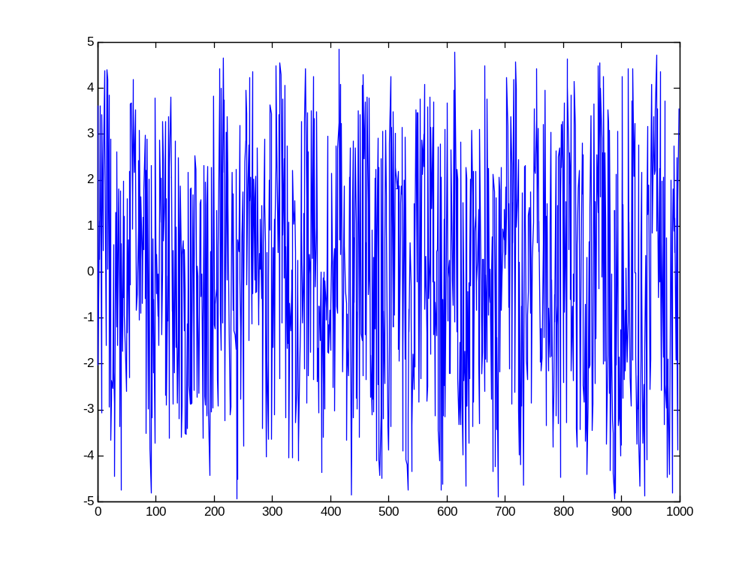
Spectrum Analysis: Signal +Lots of Noise
n

Slide 32
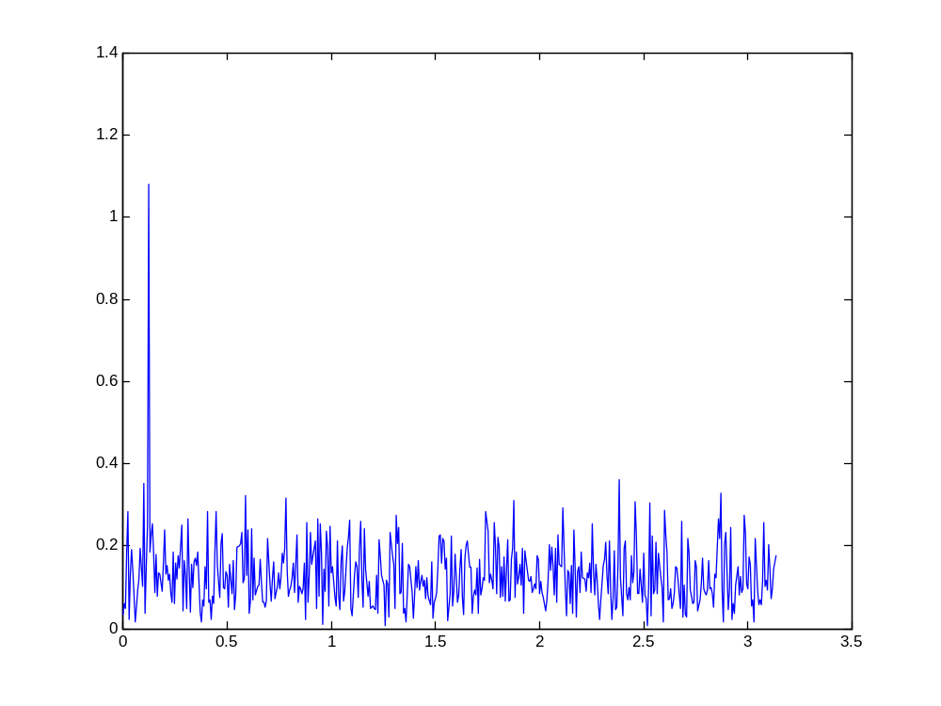
Spectrum Analysis: Fourier Transform of Signal+Noise
ω

Slide 33
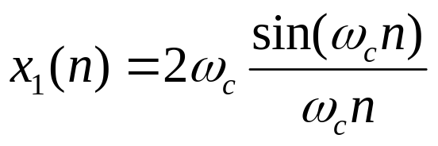
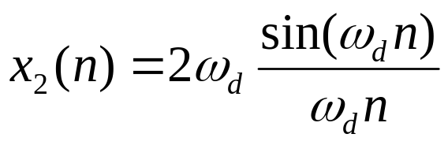
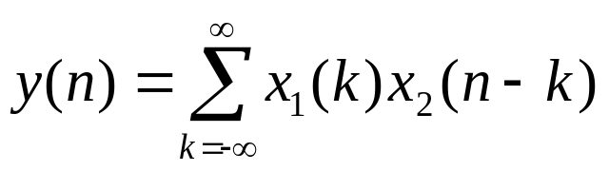
Convolution
Consider
and
How can you calculate

Slide 34
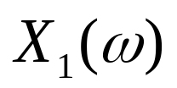

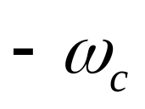
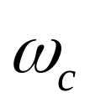
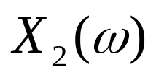
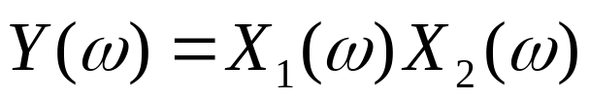
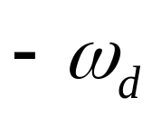
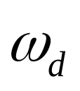
Convolution: Fourier Transform

Slide 35

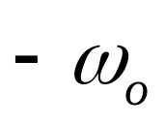
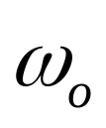
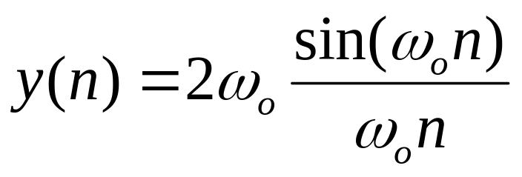

Convolution: Fourier Transform

Slide 36
Reading List
Oppenheim, A. V., Schafer, R. W., “Discrete-time Signal Processing,” Prentice-Hall, India, 1989.

